Slide 1

Using the Internet from Home:
The Physical Layer
Chapter 3
Copyright Raymond R. Panko 1998, 1999
Revised February, 1999

Slide 2
Analog Transmission
In analog transmission, the state of line can vary continuously and smoothly among an infinite number of states.
Strength
Time

Slide 3
Digital Transmission
In digital transmission, time is divided into periods of fixed length.
The line is kept in one of only a few possible states (conditions) during each time period.
Strength
Time
Time Period

Slide 4
Digital Transmission
At the end of each time period, the line may change abruptly to another of these states.
  Can also stay the same.
Abrupt
Change
Strength
Stays Same
Time
Time Period

Slide 5
Digital Versus Binary Transmission
Digital transmission: a few states
Binary transmission: only two states (1 and 0)
Few States
Two States
1
0
Digital
Binary

Slide 6
States and Bits
2^{Number of bits per time period}=Number of states
  For 1 bit per time period
  2 states are required
  Binary
1
1
States
0
0
0
0
One Time Period

Slide 7
States and Bits
2^{Bits per time period}=States/time period
  For 2 bit per time period, 4 states are required
  For 3 bits per time period, 8 states are needed
  For 4 bits per time period, 16 states are needed
3 (11)
10
11
2 (10)
01
States
1 (01)
00
0 (00)
One Time Period

Slide 8
Bits and Baud
Baud Rate = Number of possible line changes/sec.
  In this example, 4 baud (not 4 bauds/second)
  Note: possible line changes, even if not made
Bit Rate = Number of bits/second
  In this example, 8 bits/second
10
Possible Change Not Made
01
01
00
1 Second

Slide 9
Benefits of Digital Transmission
Digital Signal Processing brings ...
Inherent Reliability
  Can Regenerate Slightly Damaged Signals
  There are only a few states. Change to closest
  E.g., if two states are +10 (1) and -10 (0) volts and the signal is +8v, the signal is a 1.
Original
Received
Regenerated

Slide 10
Benefits of Digital Transmission
Error detection and correction
  Can correct errors in transmission
  Send it three times. If two are the same, OK
  Actual techniques are more efficient
    Add a few bytes of error-checking information
    Can ask for retransmission if an error is detected
110
Original
110-110-110
Sent (3 times)
110-110-111
Received (error)
110
Read 2 of 3

Slide 11
Error Detection vs Error Correction
Error Detection
  Detect than an error exists
  May simply discard incorrect message
Error Correction
  If an error is detected, the message is retransmitted
  Or, the error is fixed in context, as in the example

Slide 12
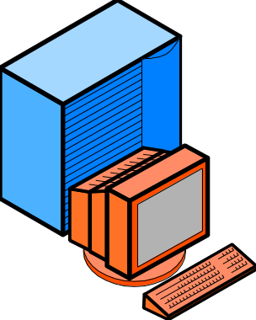


Benefits of Digital Transmission
New: Not
in Book
Encrypt (scramble) messages so that someone intercepting them cannot read them

Slide 13
Benefits of Digital Transmission
Digital Signal Processing brings ...
Compression
  Compress message before transmission
  Decompress at other end
  Compressed message places lighter load on transmission line, so less expensive to send
  Not always used
10101001
1010
Original
Signal
Compressed
Signal

Slide 14
Benefits of Digital Transmission
Multiplexing
  Multiple signals share the cost of the line
  Greatly reduces costs
  Very widely used in digital transmission
No
Multiplexing
--several lines
Multiplexing
--only one line

Slide 15
Benefits of Digital Transmission
New: Not
in Book
The Bottom Line
  More reliable
  Encryption
  Yet costs less than analog

Slide 16
Transmission Speeds
Bit: A single 1 or 0
Bits per second (bps)
  Factors of 1,000 (not 1,024 as in memory)
  kilobits per second (kbps)--Note lower case k
  megabits per second (Mbps)
  gigabits per second (Gbps)
  terabits per second (Tbps)
Occasionally given in bytes per second (Bps)
  Bits per second / 8
100101001 ...

Slide 17
Wire Propagation Effects
Propagation Effects
  Signal changes as it travels
  Receiver may not be able to recognize it
Original
Signal
Final
Signal
Distance

Slide 18
Wire Propagation Effects: Attenuation
Attenuation: Signal Gets Weaker as it Propagates
  May become too weak to recognize
Signal
Strength
Distance

Slide 19
Wire Propagation Effects: Distortion
Distortion: Signal changes shape as it propagates
  Adjacent bits may overlap
  May make recognition impossible for receiver
Distance

Slide 20
Wire Propagation Effects: Noise
Noise: Thermal Energy in Wire Adds to Signal
  Noise floor is average noise energy
  Random signal, so spikes sometimes occur
Signal
Spike
Signal
Strength
Noise
Noise Floor
Time

Slide 21
Wire Propagation Effects
Noise and Attenuation
  As signal attenuates, gets closer to noise floor
  So noise is a greater problem with distance
Signal
Strength
Signal
Noise Floor
Distance

Slide 22
Wire Propagation Effects: SNR
Want a high Signal-to-Noise Ratio (SNR)
  Signal strength divided by average noise strength
  As SNR falls, errors increase
Signal
Strength
Signal
SNR
Noise Floor
Distance

Slide 23
Wire Propagation Effects: Noise & Speed
Noise and Speed
  As speed increases, each bit is briefer
  Noise fluctuations do not average out as much
  So noise errors increase as speed increases
Error
Rate
Speed

Slide 24
Wire Propagation Effects: Interference
Interference
  Energy from outside the wire
  Adds to signal, like noise
  Often intermittent, so hard to diagnose
Signal
Strength
Signal
Interference
Time

Slide 25
Wire Propagation Effects: Termination
Interference termination problem
  Often, multiple wires in a bundle
  Each radiates some of its signal
  Causes interference in nearby wires
  Especially bad at termination, where wires are unwound and
  parallel
Termination

Slide 26
Practical Issues in Propagation Effects
Distance limits in standards prevent serious propagation effects
  For instance, usually 100 meters for UTP
  If stay within limits, usually no serious problems
Problems usually occur at connectors
  Untwisting UTP more than 0.5 inches creates serious interference between adjacent wire pairs

Slide 27
Wire Media: UTP
Unshielded Twisted Pair (UTP)
  Ordinary wire
  Pair for two-way signal
  Unshielded: nothing but plastic coating
    No protection from interference

Slide 28
Wire Media: Twisting in UTP
UTP
  Twisted to reduce interference effects
  In two halves of each twist, interference works in opposite directions, so tend to cancel out.
Power added
Net power is zero

Slide 29

Wire Propagation: RJ-45
RJ-45 connector terminates a UTP bundle
  Slightly thicker than RJ-11 residential connector
  For 8 wires.

Slide 30
Wire Media: UTP to the Desktop
UTP
  Dominant for line to desktop
  Inexpensive
  Rugged: can take punishment of office work
  Easily 100 Mbps, possible to 1 Gbps
UTP

Slide 31
Wire Media: Optical Fiber
Optical Fiber
  Glass core, surrounding glass cladding
  Total internal reflection at boundary
  Almost no loss
Cladding
Core
Light
Source
Reflection

Slide 32
Wire Media: Optical Fiber
Optical Fiber
  High speeds over long distances
    200 m to 2 km
  Costs more than UTP, but worth it on long runs
  Good for all links in buildings except the final link to the desktop
Optical
Fiber

Slide 33
Wire Media: UTP and Optical Fiber
UTP to desk, Fiber everywhere else on site

Slide 34

Wire Media: Coax
Coaxial Cable
  Used in cable TV, VCRs
  Central wire, external concentric cylinder
Inner
Wire
Outer Conductor Wrapped in PVC
Screw-On Connector

Slide 35
Wire Media: Coaxial Cable
Coaxial Cable
  Installed widely today
  Not being used in new installations
  Optical fiber more cost-effective for long links
  UTP more cost-effective for desktop links

Slide 36

Radio Propagation
Broadcast signal
  Not confined to a wire

Slide 37
Radio Propagation: Waves
Waves
Frequency (Hz)
Cycles per Second
Wavelength
(meters)
One Second
Amplitude
(power)
1 Hz = 1 cycle per second

Slide 38
Radio Propagation: Frequency Spectrum
Frequency Spectrum
  Frequencies vary (like strings in a harp)
  Frequencies measured in Hertz (Hz)
  Frequency spectrum: all possible frequencies from 0 Hz to infinity
0 Hz

Slide 39
Frequencies
Metric system
  kHz (1,000 Hz)
  MHz (1,000 kHz)
  GHz (1,000 MHz)
  THz (1,000 GHz)

Slide 40
Radio Propagation: Service Bands
Service Bands
  Divide spectrum into bands for services
  AM radio, FM radio, cellular telephone, etc.
Cellular Telephone
Service
Bands
FM Radio
AM Radio
0 Hz

Slide 41
Radio Propagation: Channels and Bandwidth
Service Bands are Further Divided into Channels
  Like television channels
  Bandwidth of a channel is highest frequency minus lowest frequency
Channel
Bandwidth
Channel 3
Service
Band
Channel 2
Channel 1
0 Hz

Slide 42
Radio Transmission: Broadband
Speed and Bandwidth
  The wider the channel bandwidth, the faster the maximum possible transmission speed
  In general, fast systems are called “Broadband” even if they do not use channels
Speed
Bandwidth

Slide 43
PC Serial Ports
Ports
  Connectors at back of PC
  Plus related internal electronics to send/receive

Slide 44
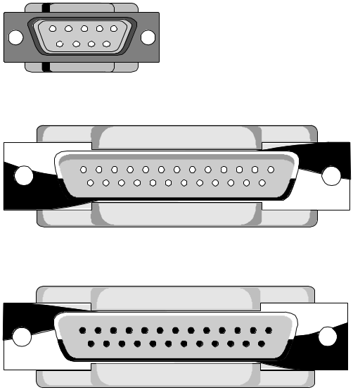
PC Serial Ports: 9-Pin and 25-Pin Ports
9 pins or 25 pins
Parallel ports have 25 holes
9-pin Serial Port
Pins
25-pin Serial Port
25-pin Parallel Port
Holes

Slide 45
PC Serial Ports: Send on One Pin
9-Pin Ports
  PC sends on Pin 3
  PC receives on Pin 2
  Pin 5 is a signal ground defining zero volts
  Most other pins are control signals to tell other side when it may transmit

Slide 46
PC Serial Ports: Voltages
For sending data
  One is -3 to -15 volts
  Zero is +3 to +15 volts
+15v
0
0
1
-15v

Slide 47
Duplex
Full-duplex transmission: both can transmit simultaneously
  Even if only one sends, still full-duplex line
  Even if neither is sending, still full-duplex line
A
B
A
B
A
B
Time 1
Both may send.
Both do
Time 1
Both may send.
Only A does
Time 1
Both may send.
Neither does

Slide 48
Duplex
Half-duplex transmission: only one can transmit at a time. Must take turns.
  Walkie-talkie
A
B
A
B
Time 1
Only one side
May send
A does
Time 2
Only one side
May send
Neither does

Slide 49
Serial and Parallel Transmission
Serial: one wire, one bit per clock period*
1
0
One
Bit in
Clock
Cycle
One
One
Bit in
Clock
Cycle
Two
*For simplicity, we assume binary transmission (2 states)

Slide 50
Serial and Parallel Transmission
Parallel
  N bits per second on N wires
  Parallel is faster than serial
1
1
1
1
0
Eight Bits
In Clock
Cycle One
0
Eight Bits
In Clock
Cycle Two
1
1
1
1
0
0
0
0
0
0

Slide 51
Serial and Parallel Transmission
Parallel Transmission
  N bits per second on N wires
  N=8 in this example
  N can also be 2, 4, 16, 32, etc.
1
1
1
1
0
0
1
1
1
1
0
0
0
0
0
0

Slide 52
Connecting to the Internet
Need 4 Things:
  Fast Enough Port on PC
  Modem
  Carrier Transmission Line to ISP
    Telephone line (have one; no extra cost)
    ISDN line
    Cable line
    Telephone company DSL line
  ISP
    Cost is separate from transmission line cost

Slide 53
Modems
Problem
  Computer is digital
  Telephone line is analog
  Need translation device called a modem
Analog
Signal
Digital
Signal
(1101)
Modem

Slide 54
Modems
Note:
  Device is digital;Transmission line is analog
  Cannot say just “modem translates between analog and digital” (For analog device and digital transmission line, need something else)
Digital
Device
10101
Analog
Transmission Line

Slide 55
Modulation
Digital 1s and 0s are turned into vibrations
Example: Frequency Modulation
  1 is a high-frequency vibration
  0 is a low-frequency vibration
0
1
1
1

Slide 56
Modem Forms
Internal Modem
  On printed circuit board inside PC
  Does not take up desktop space
  Can be difficult to install

Slide 57
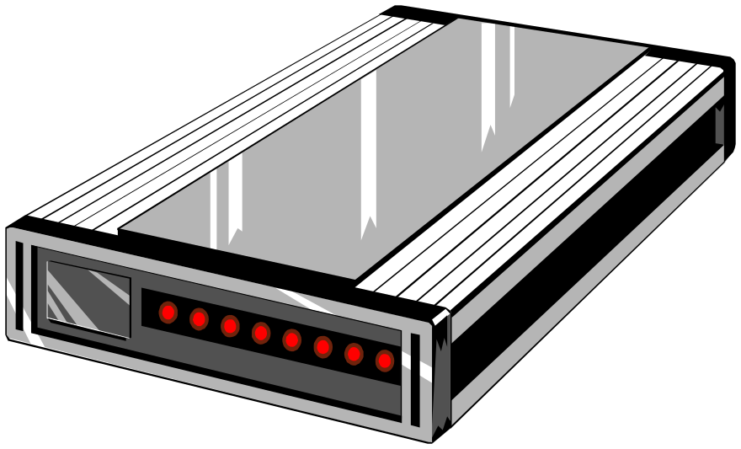
Modem Forms
External Modem
  Easy to install
  Takes up desk space
  Need wire to serial port
  Need power supply

Slide 58

Modem Forms
PC Card Modems
  Fit in PC Card slots on notebooks
  Easy to install
  Does not take up desktop space
  Expensive
  Not useful for desktop PCs

Slide 59
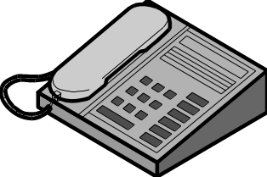
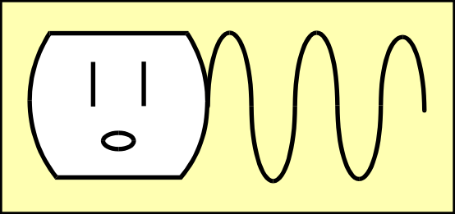
Modem Connection
Phone
Line to
Telephone
Serial Cord
to Serial
Port*
Phone Line to
Wall Jack
Wall Power:*
usually uses
“brick” transformer
*Only for external modem

Slide 60
Modem Standards
Two Modems Must Follow Same Standards
  Speed standards (modulation method)
  Error correction and compression standards
  Facsimile standards
Training Period
  When two modems first start talking, they negotiate standards to use. Settle on highest common standards.

Slide 61
Modem Speed Standards (ITU-T)
V.90
  Receive at 56 kbps
  Send at only 33.6 kbps
  Not all phone lines, ISPs support 56 kbps
  Fall back to 33.6 kbps if cannot support
V.34
  33.6 kbps send and receive
V.32 bis
  14.4 kbps send and receive

Slide 62
Modem Standards: Error Correction and Compression
ITU-T
  V.42: Error correction and detection
  V.42 bis compression (up to 4:1)
  Most newer modems have both
MNP
  Both error detection/correction and compression
  Mostly in older modems

Slide 63
Modem Standards
Facsimile
  Most modems also act as fax modems
  Facsimile requires different modulation than data transmission
  V.14: 14.4 kbps
  V.29: 9.6 kbps

Slide 64
Alternatives to V.34 (33.6 kbps) Modems
V.90 Modems
ISDN
Digital Subscriber Lines (DSLs)
Cable Modems
Wireless Access
Ports

Slide 65
V.90 Modems
Telephone Bandwidth is Limited
  300 Hz to 3400 Hz (3,100 Hz bandwidth)
  Varies slightly from one phone company to another
Bandwidth
3,100 Hz
Sound
Loudness
0
300
3400
20,000

Slide 66
V.90 Modems
Telephone Bandwidth is Limited
  Bandwidth limits speed
  Limits speed to about 35 kbps
  When you transmit, limited to 33.6 kbps
33.6 kbps

Slide 67
V.90 Modems
Telephone Bandwidth is Limited
  Limits occur when you transmit in analog to the phone company
    Analog-to-digital converter at the telephone company limits you to 33.6 kbps
Telephone
Network
PC
V.34
modem
ADC
33.6 kbps

Slide 68
V.90 Modems
Receive at 56 kbps
  ISP connects with digital line to the telco
  No analog-to-digital converter to limit speed
  56 kbps digital channels inside phone network
Digital
Link
Telephone
Network
PC
56 kbps
modem
ISP
DAC
No
ADC!

Slide 69
V.90 Modems
Receive at 56 kbps
  Telephone company uses 56 kbps circuits internally
  Telephone company transmits in analog to subscriber at 56 kbps
Digital
Link
Telephone
Network
PC
56 kbps
modem
ISP
DAC

Slide 70
V.90 Modems
Limits
  Not all telephone lines support 56 kbps service
  Not all ISPs support V.90 modems
  ISPs may charge more for service
Telephone
Network
ISP

Slide 71

Conversion
Device versus Line
Device
Transmission Line
Translator
Analog Line
Digital Line
Analog Device
Codec
Digital Device
Modem
DSU

Slide 72
ISDN
Get ISDN line from telephone company
  Multiplexes (mixes) three signals on one line to the desktop
B
Channel
D Channel:
control signals
ISDN
Modem
1101
2B+D
Multiplexed
Onto One
Set of Wires
B
Channel

Slide 73
ISDN
B Channels are 64 kbps
Original idea: one for voice, one for data
Can now “bond” the two B channels for 128 kbps data if ISP supports it
D Channel is 16 kbps (for supervisory signaling)
B
Telephone
Network
ISDN
Modem
ISP
B
128
kbps

Slide 74
ISDN Costs
Must install an ISDN line
  Not the case with modems unless addicted
Line is expensive ($60-$80/mo.) to install and use
  Only for transmission to ISP
  ISP charge is separate; charge more for ISDN access
Dial Up: Not always connected
  Do not have to pay for full-time use
Need “ISDN modem” (expensive)

Slide 75
ISDN Modem
Misnomer
  Modem for digital device, analog line
  ISDN line is digital
ISDN modem really contains
  Codec to link analog telephone to digital ISDN line
  Data service unit (DSU) to translate between PC digital format and ISDN digital format (voltage levels, timing, etc.)

Slide 76
ISDN Modem
Codec
  Translates analog device signal into digital signal for propagation
  Constantly samples the intensity of the analog signal
Sample
0110010
1/8,000 sec

Slide 77
ISDN Modem
Codec
  Divides each second into 8,000 sampling periods
  Only measures amplitude of signal in each
  Measures amplitude to an 8-bit intensity value
  Sends 8 bits 8,000 times per second (8 kbps)
Sample
Intensity
Value
0110010
1/8,000 sec Sampling Period

Slide 78
DSU (Data Service Unit)
Translates between different digital formats
  Device and line are both digital, but may have..
    Different bit rates
    Different number of possible states
    Different voltage levels for the states
    Different ways to represent ones and zeros
Digital Line
DSU

Slide 79
Cable Modems
Service of Cable Television Companies
  Deliver 10 Mbps downstream to the home
  Shared capacity, so real speed is more limited
  Limited to about 64 kbps upstream
  Does not tie up telephone line
  Instantly available
Cable TV
Network
Cable
Modem
Also ISP
Functions

Slide 80
Cable Modems
Cost is $40-$60
  Includes ISP service!
  Must buy a cable modem
  Best alternative today beyond V.90 modem
  Cost-competitive with adding a second phone line to handle your modem communication

Slide 81
Digital Subscriber Lines (DSLs)
Offered by Telephone Companies
  Lines to customer premises are subscriber lines
  These are digital
  Several types of digital lines for subscribers
  Usually multiplexes regular phone, high-speed data
Telephone
Network
DSL
Modem
DSL
ISP

Slide 82
Digital Subscriber Lines
Most common is Asymmetric DSL (ADSL)
  Upstream and downstream speeds are different
  Upstream at 64 kbps is common
  Downstream at 128 kbps to several Mbps
  Good for WWW
Telephone
Network
DSL
Modem
ADSL
ISP
64 kbps
128 kbps-8 Mbps

Slide 83
Digital Subscriber Lines
New Information
G.Lite (G.922.2) Standard
  New ADSL standard from ITU-T
  1.5 Mbps downstream speed
  No carrier installation is necessary
  Will be offered at lower speeds for lower price
Telephone
Network
DSL
Modem
ADSL
ISP
64 kbps
1.5 Mbps

Slide 84
Ports
Need port fast enough for line
Serial port to 115.2 kbps: only V.34, V.90 or ISDN
USB (universal serial bus)
  12 Mbps. Available on new PCs
  Fast enough for DSLs, cable modems

Slide 85
Ports
Firewire
  400 Mbps and faster
  Not available on most new PCs
  Fast enough for DSLs, cable modems
Ethernet NIC (10 Mbps)
  Network interface card used in PC networks
  Printed circuit board
  Must be installed inside PC systems unit
  Fast enough for DSLs, cable modems

Slide 86
Ports
Wireless Internet Access
  Emerging alternative
  Will vary greatly in speed
  Terrestrial and satellite

Slide 87
Recap
Analog versus Digital
Advantages of Digital
  More reliable, security, AND cost savings
  Few possible states versus two (binary)
Bit Rate versus Baud Rate
  Bit rate: number of bits per second
  Baud rate: number of possible line changes/second

Slide 88
Recap
Wire Propagation Effects
  Attenuation
  Distortion
  Noise
  Interference
  Noise gets worse with distance & speed
Radio Propagation
  Frequency Spectrum
  Service Bands
  Channels and Bandwidth
  Broadband

Slide 89
Recap
Wire Media
  UTP to the desktop
  Optical fiber elsewhere at the site
  Coaxial cable is used but fading
Ports
  Serial versus parallel
  Half-duplex versus full duplex
  Voltage levels

Slide 90
Recap
To Connect to the Internet
  Port
  “Modem”
  Carrier transmission line to ISP
  ISP

Slide 91
Recap
Modems
  Digital devices, analog transmission lines
  Forms (internal, external, & PC Card modems)
  Training
  Speed standards
  Compression and error correction standards
  Facsimile standards

Slide 92
Recap
Translation Device
  Analog or Digital Device
  Analog or Digital Line
Analog Line
Digital Line
Analog Device
Codec
Digital Device
Modem
DSU

Slide 93
Recap
Alternatives to V.34 modems
  V.90 modems
  ISDN (requires new line)
  Cable modems (requires new line)
  DSLs (requires new line)

Slide 94
Recap
Ports (must be fast enough for line)
  Serial
  USB
  Firewire
  NIC for LAN

